Slide 1
StackWave Affinity
Antibody Discovery LIMS

Slide 2
Who is StackWave?
2012
StackWave is Founded
2014
Platform Development Begins
2018
Biologics LIMS Product Announced
2019
ELN and SDMS Product Completed
2021
StackWave Affinity Antibody Discovery LIMS Launched
StackWave…
  Was founded with a primary focus on development services for Antibody Discovery informatics
  Fosters an organizational culture of lifelong learning, craftsmanship, and empathy
  Comprises a leadership team of software and biomedical engineers with decades of antibody discovery
  Deeply empathizes with our partners when it comes to the complexities that present in novel biologic workflows

Slide 3






Why Affinity
Facilitates team collaboration
Simplifies target identification
Effective inventory management
Single source of truth for all sample data
In-depth analysis of lead antibodies
Full antibody lineage and traceability

Slide 4
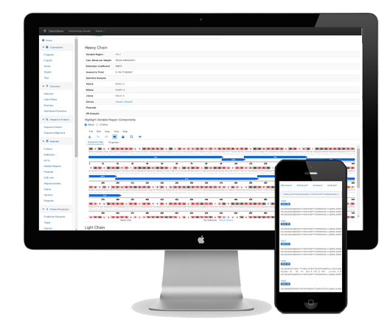
Modern Tools for Antibody Discovery
Hybridoma Production
Phage Panning
Sequence Analysis
Lead Characterization
Antibody Screening
Inventory Management
Protein Expression
High-throughput Screening

Slide 5
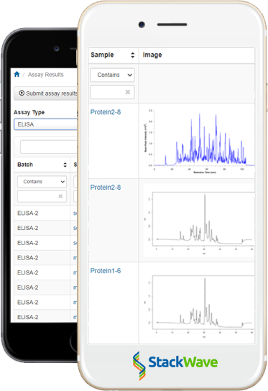
Advanced Data Capture
Out-of-the-box assays support includes
ELISA
Kinetics
Endotoxin
Mass Spec
SEC Purity
Sequencing
Stability
... and the list is always growing
Create custom assay types using the StackWave Assay Builder

Slide 6






How do Antibody Discovery Teams use Affinity?
Create projects to organize data
Run selection campaigns to identify leads
Generate samples for downstream analysis
Run assays to perform detailed characterization
Manage physical sample inventory and requests
Generate custom reports to facilitate collaboration

Slide 7
Don’t settle for a LIMS that was made for everyone, Affinity was made for you.
Web: http://stackwave.com
Email: inquiries@stackwave.com

